Slide 1
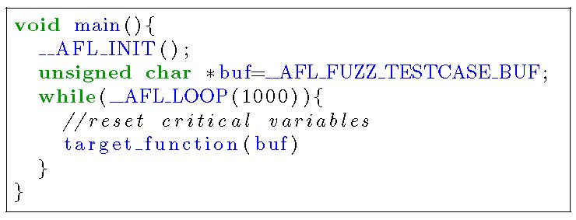
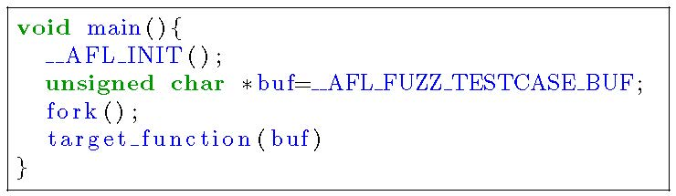
Persistent Mode for Fuzzing
Feed inputs to a target program within a process instead of forking and initializing the target program for each input
By reliably reset to a nearly-pristine state across inputs
To avoid the expensive forking and initialization
“This is the most powerful and effective fuzzing you can do.”
“All professional fuzzing uses this mode.”

Slide 2
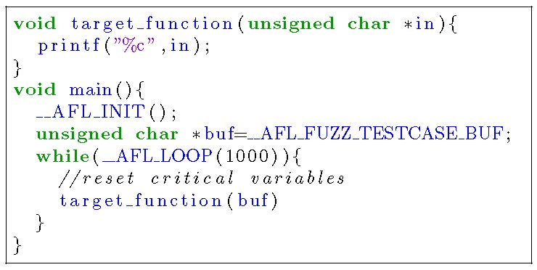
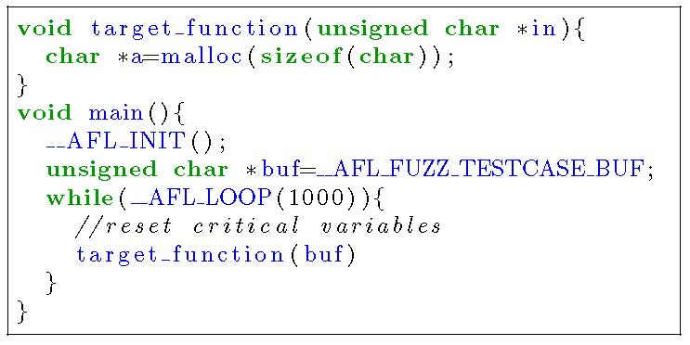
Persistent Mode on Fuzzing Stateless Programs
No need of state reset in principle
Because of no critical variable (i.e., variables that store the results of previous run and are used in a future run)
Unexpected termination of Fuzzing due to memory leak on stateless programs
The target_function does not store any results for future execution (i.e., stateless).
Finally the malloc fails due to memory leak and the fuzzing may terminate unexpectedly.
AFL++’s persistent mode handles the unexpected side effect.

Slide 3
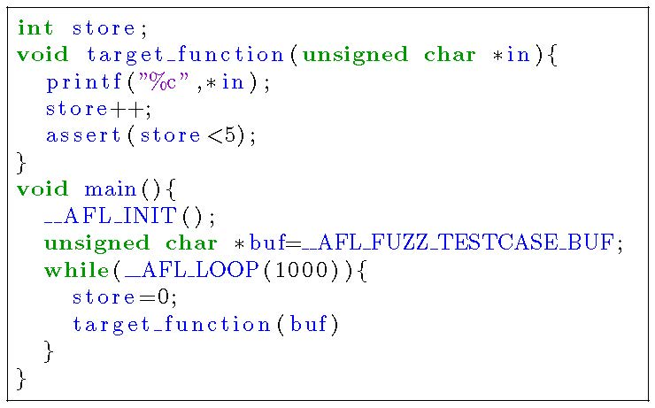
Persistent Mode on Fuzzing Stateful Programs
Need state reset to provide clear environment to a next input’s run
Global variable (i.e., state)
The target_function counts the number of calls and use the count in future runs.
Reset the global variable
to avoid side effects
How to find a bug exposable by only a sequence of function calls
(ex. invoke target_function(buf) five times to reach the assertion failure)

Slide 4



Idea: Automated Stateful Gray-box Fuzzing
Target bugs exposable by only a sequence of API calls in a stateful white-box program
state
API and
input pair
Input
(a sequence of APIs and inputs)
Input
State
API
Input for API
$$s_{1}$$
$$a_{1},i_{1}$$
…
$$s_{2}$$
Stateful
Program
Initial
State
Input
Queue
Stateful
Program
Input
Queue
$$a_{1},i_{1}$$
$$s_{3}$$
…
$$a_{1},i_{1}$$
Coverage
Analysis
Coverage
Analysis
…
Fuzzing stateful program
in persistent mode
Fuzzing stateful program
by tracking intermediate states

Slide 5
Discussion
How many programs are stateful and white-box?
Impossible state reset due to black-box back-end for fuzzing stateful black-box programs in persistent mode
ex) fuzzing API of cloud services
Extract a sequence of API calls from logs and API descriptions
Fuzzer
inputs
state
reset
APIs
White-box
Black-box
Cloud

